Slide 1


Reversible Multifunctional Open-source Urban Landscape in Nitra (Slovakia) – VIS Implementation Plan
Katarína Melichová (SUA)
Jana Popovicsová (HIDE)
WP 4
IN-HABIT General Assembly 03.10.2022
Notes:
Let me present how we can create a landscape in Nitra that will showcase solutions to some of our pressing problems.

Slide 2


Current process and next steps
4.3 Co-deployment of VIS and 4.4 Co-management of VIS
Almost all VIS are separate „projects“
Co-deployment procedures will take form of tri- and bilateral cooperation agreements and lease agreements (currently being prepared), inviting experts to co-organise workshops and events, sharing resources, artist residencies, open calls and public competitions etc., with heavy involvement of volunteers
Technical documentation prepared in-house not subcontracted
Involvement of investors to co-manage several hard VIS
Several procurement procedures concluded (e.g. for plant material)

Slide 3
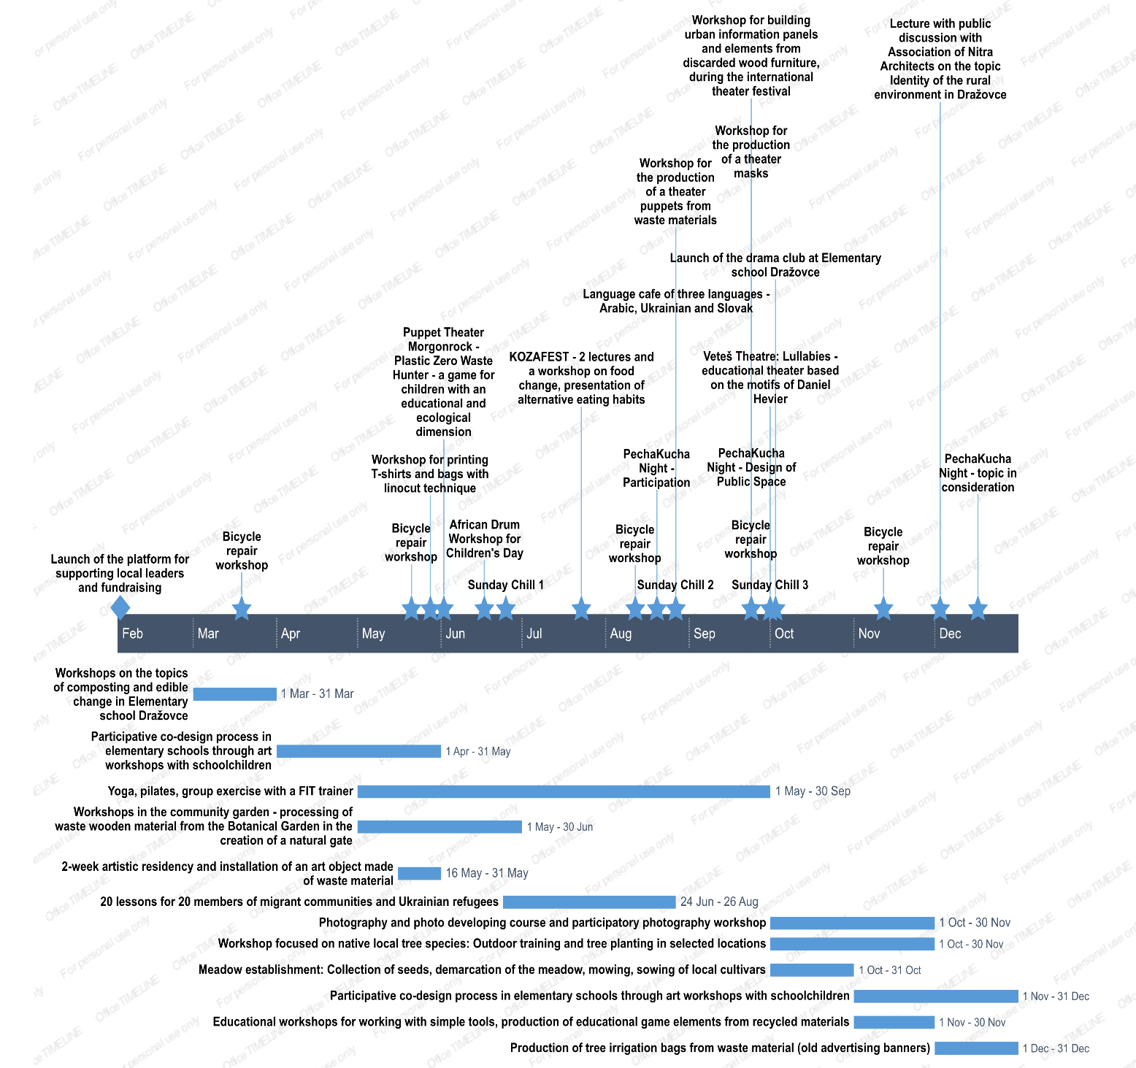

Slide 4
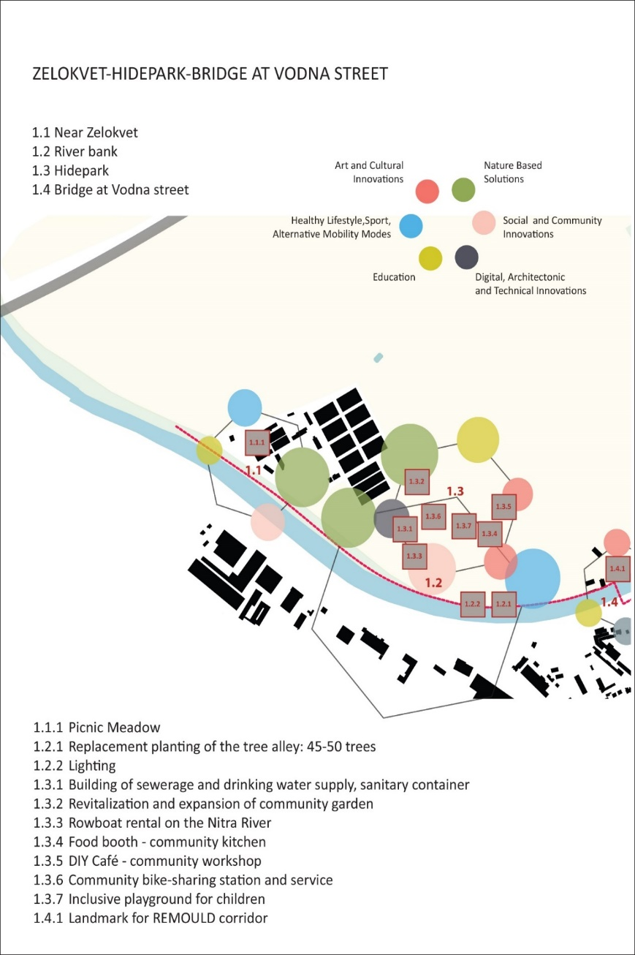
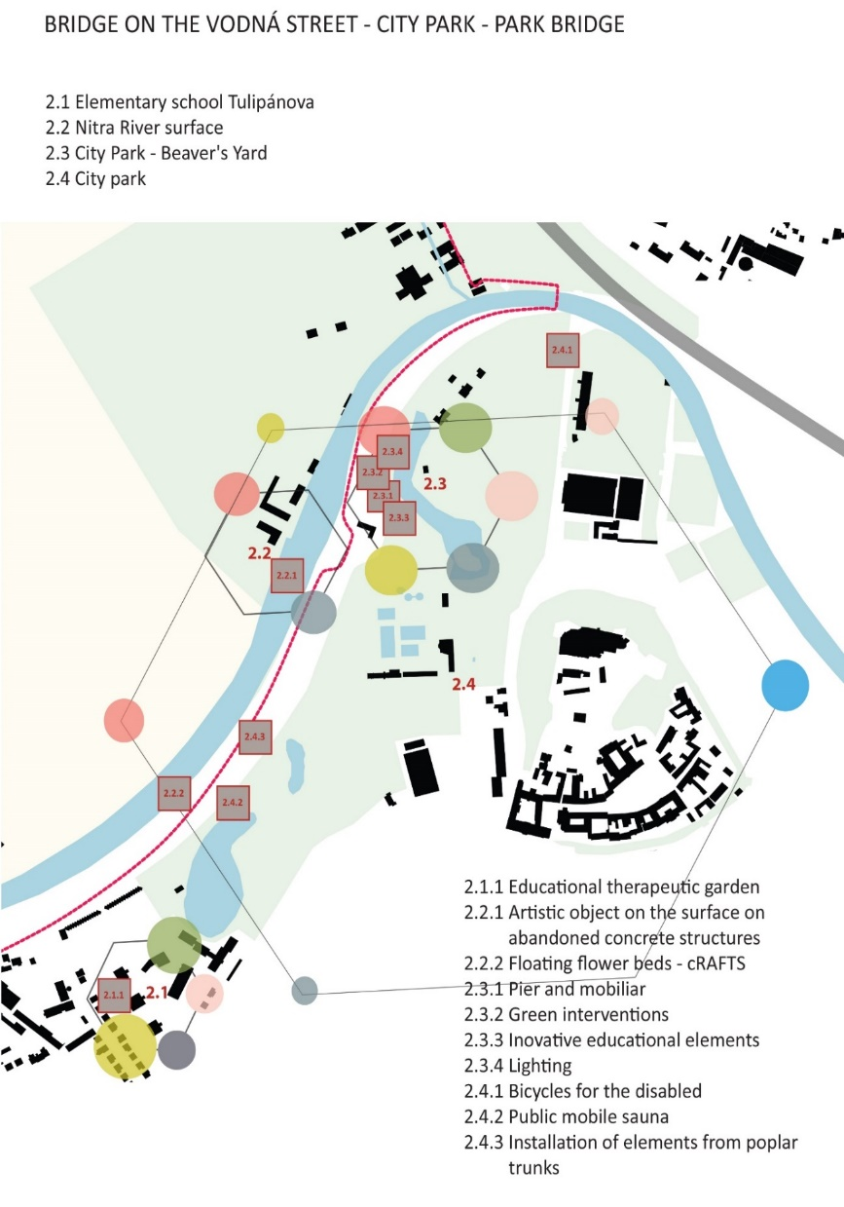

Slide 5
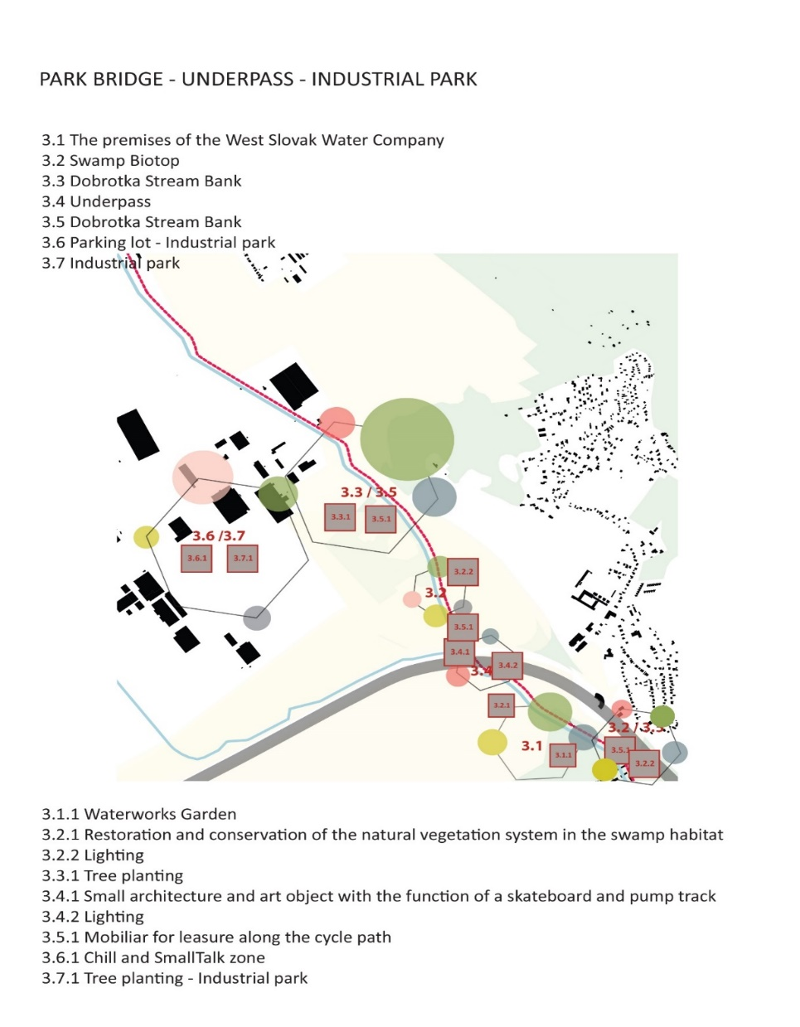
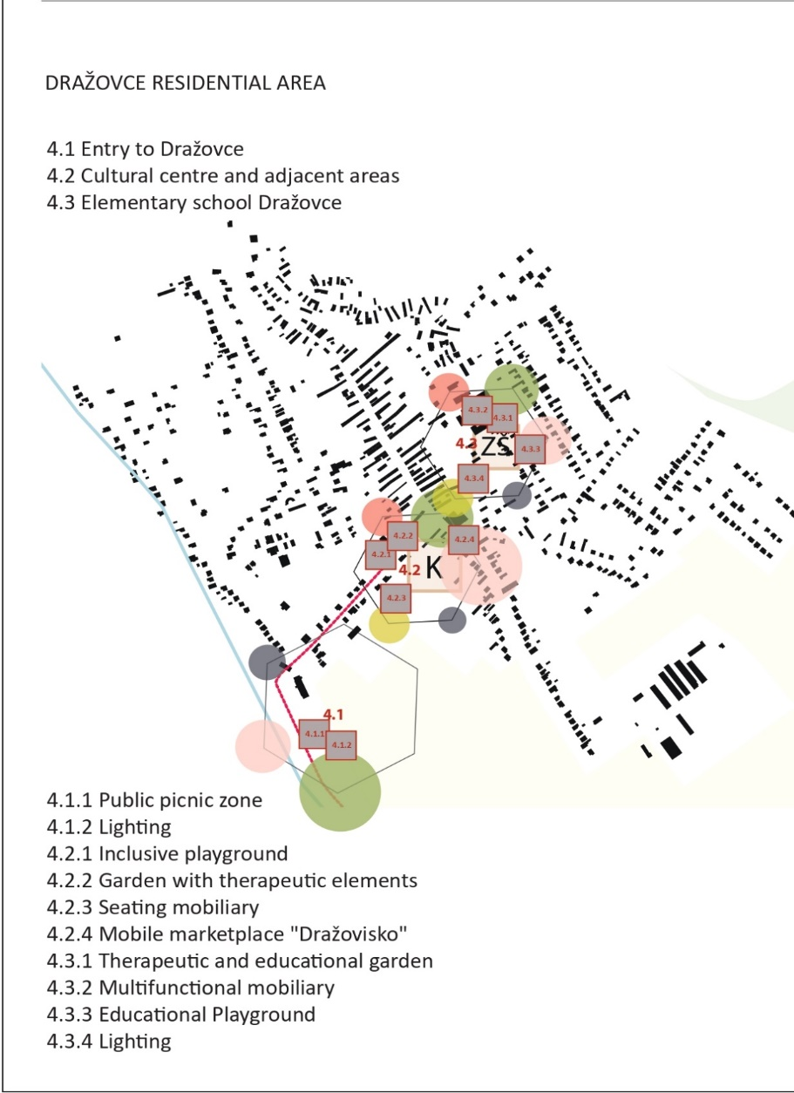

Slide 7
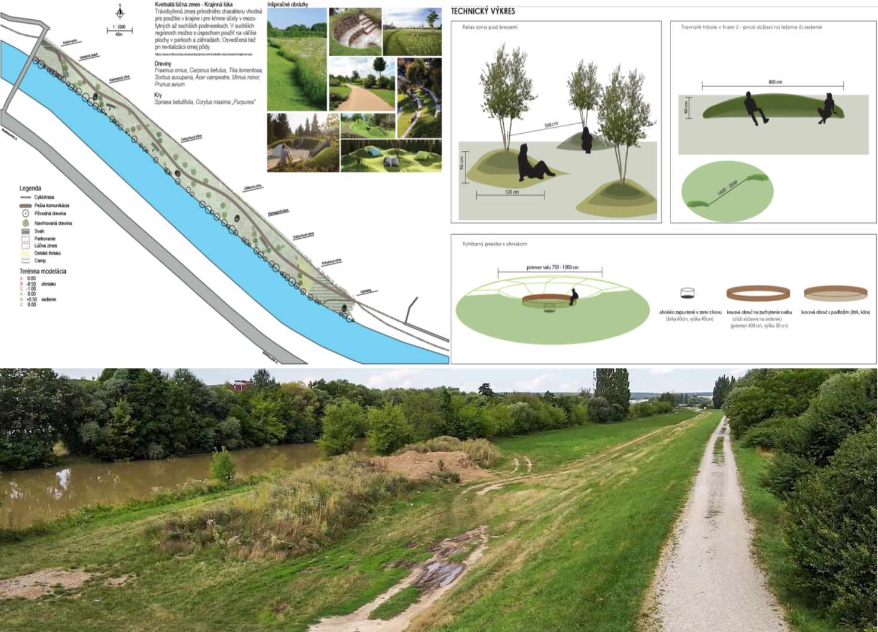

Slide 9
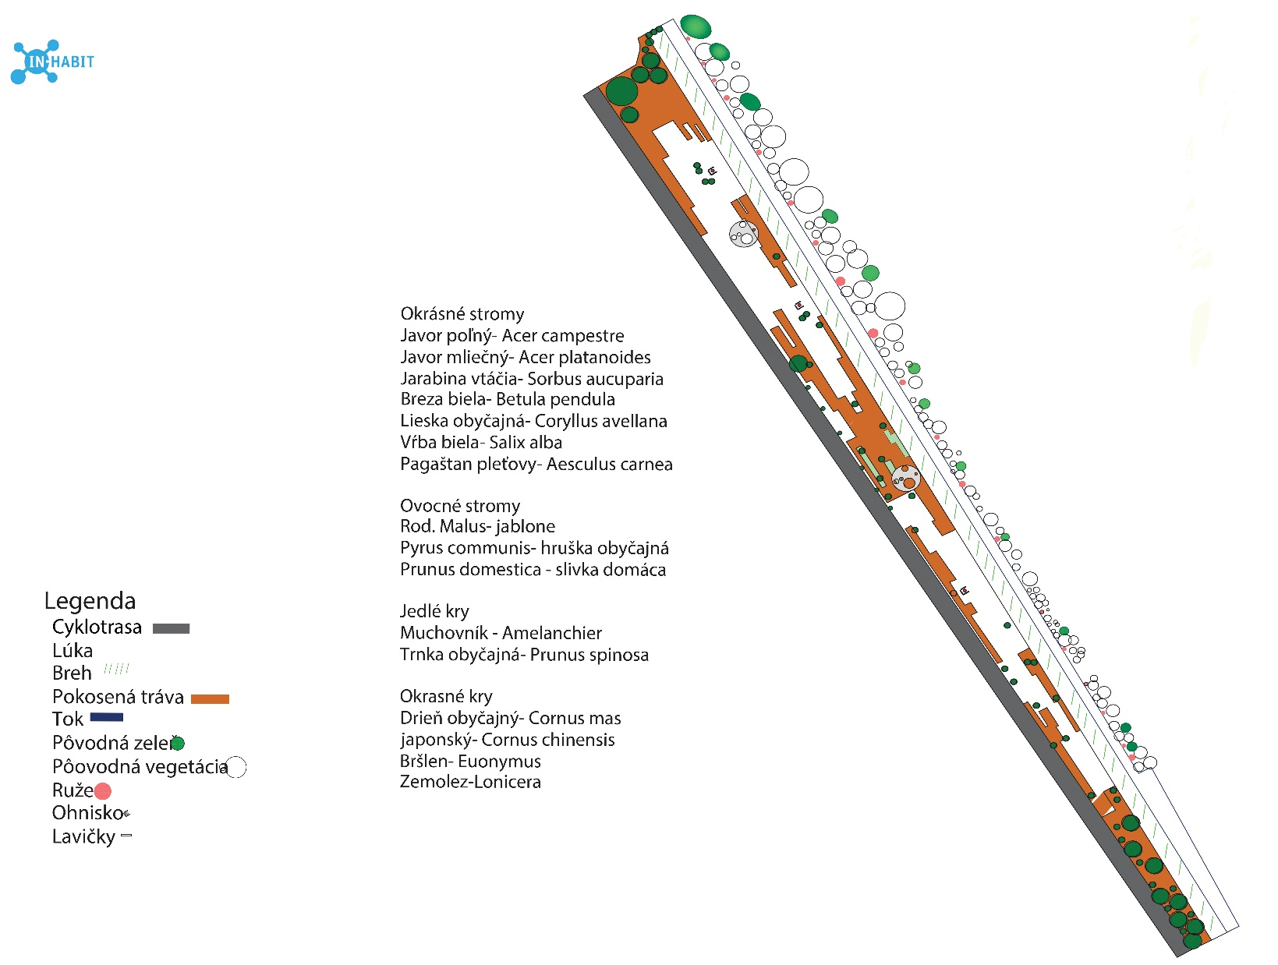

Slide 11
Thank You

